Slide 1

Parking Lot Detection and Booking System
Rohan Patil (22106044)
Aditya Sawant (22106084)
Ankit Pawar (22106111)
Aryan Kharat (23206001)
Project Guide
Ms. Yogeshwari Hardas
Notes:
1

Slide 2
Outline
Introduction
Literature Survey of the Existing Systems
Limitations of the Existing Systems
Problem Statement
Proposed System Design
Framework/Algorithm
Technologies Stack for Proposed System
Implementation
Conclusion
References
Notes:
2

Slide 3
Introduction
Real-Time Detection: Utilizes computer vision with OpenCV to analyze live video feeds and determine parking slot occupancy dynamically.
User-Centric Interfaces: Offers separate, intuitive portals for administrators (slot marking and management) and regular users (slot booking and payment tracking).
Efficient Resource Utilization: Optimizes parking space usage by automating detection and booking processes, reducing congestion and wait times.
Dynamic Pricing: Implements a demand-based pricing mechanism that adjusts parking rates in real time based on occupancy levels and calculated multipliers.
Notes:
3

Slide 4
Literature Survey of the existing system
Paper 1: A. Kumar, B. Singh, and C. Patel, "Real-Time Parking Slot Detection Using Image Processing Techniques," ITSC 2018
Utilizes background subtraction and adaptive thresholding for real-time detection of parking slots.
Demonstrates a practical approach while highlighting challenges under varying lighting conditions.
Paper 2: D. Li, F. Wang, and J. Chen, "Deep Learning for Parking Occupancy Detection: A CNN-Based Approach," IV 2019
Introduces a CNN model for classifying parking slot occupancy from live video feeds.
Outperforms traditional methods by effectively handling complex urban scenarios and diverse conditions.
Notes:
4

Slide 5
Literature Survey of the existing system
Paper 3: S. Rahman and M. Alam, "Smart Parking Systems: Integrating Computer Vision and IoT for Urban Mobility," ICSC 2020
Proposes an integrated framework combining computer vision with IoT to monitor parking occupancy in real time.
Emphasizes scalability and cost-effectiveness, contributing to the development of smart urban mobility solutions.
Paper 4: M. Hernandez, P. Garcia, and L. Torres, "Efficient Parking Space Detection and Vehicle Localization Using Machine Vision," CASE 2019
Focuses on using adaptive thresholding and morphological operations for accurate parking space detection and vehicle localization.
Offers insights into optimal camera placement and system calibration for enhanced detection performance.
Notes:
5

Slide 6
Literature Survey of the existing system
Paper 5: R. Gupta and S. Kumar, "Robust Parking Slot Occupancy Detection Using Image Processing and Machine Learning Techniques," IC3T 2021
Proposes a hybrid approach integrating image processing and machine learning for occupancy detection.
Achieves high accuracy and robustness across diverse environmental conditions suitable for real-world deployment.
Notes:
6

Slide 7
Limitations of Existing Systems
High Cost of Sensor-Based Systems: Traditional solutions rely on expensive IoT sensors for each parking slot, whereas our project uses a single camera with computer vision, reducing installation and maintenance expenses.
Fragmented Systems: Existing systems often separate slot detection and booking modules, leading to inefficient communication. Our integrated solution seamlessly combines real-time occupancy detection with booking management.
Static Pricing Models: Conventional systems offer fixed pricing regardless of demand. Our project introduces a dynamic pricing mechanism that adjusts rates in real time based on occupancy levels.
Manual Configuration Requirements: Sensor-based approaches demand extensive manual calibration and upkeep. Our automated video processing minimizes human intervention by dynamically detecting parking slots.
Fixed and Inflexible Parking Layouts: Traditional systems require physical sensor installation for each slot, making layout reconfiguration cumbersome. Our solution enables flexible, dynamic slot marking through an interactive admin interface, accommodating varied parking designs with ease.
Notes:
7

Slide 8
Problem statement
Urban parking management faces challenges like high vehicle density, inefficient space utilization, and lack of real-time tracking.
Existing systems rely on manual monitoring, sensor-based detection, or static pricing, leading to booking conflicts and revenue inefficiencies
.
Our solution uses image processing (OpenCV) to detect parking slots and in-memory storage for real-time booking management.
A Flask-based web application enables users to check availability, book slots, and pay dynamically based on demand.
Dynamic pricing ensures optimal space utilization and revenue maximization based on real-time occupancy.
The system is cost-effective, scalable, and eliminates the need for expensive IoT sensors, making it suitable for modern parking management.

Slide 9
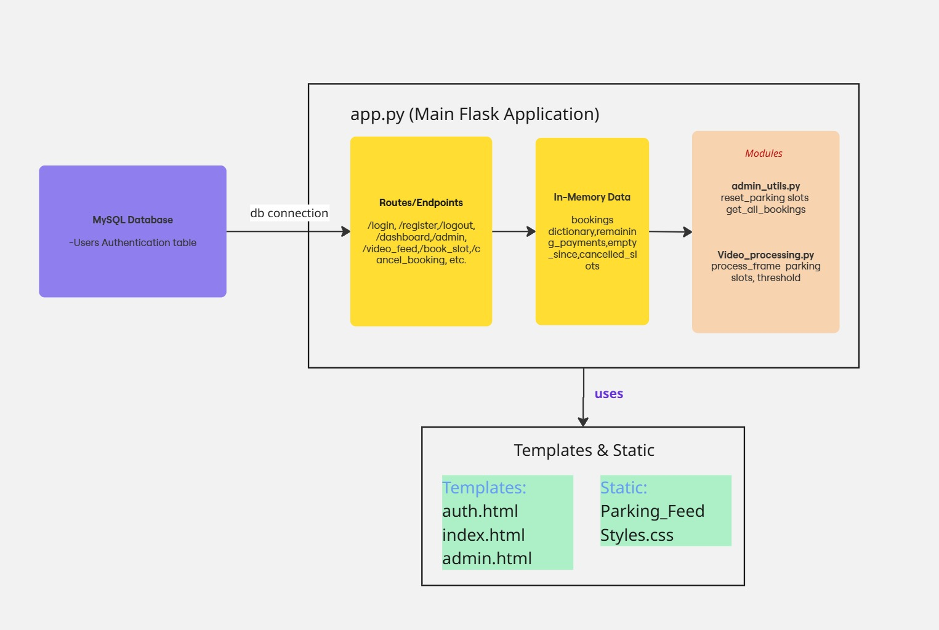
System Design

Slide 10
Framework
Modular Flask Architecture: Built on Flask, the system employs a modular design with dedicated modules for video processing, admin utilities, and booking operations, ensuring maintainability and scalability.
Real-Time Video Processing: Integrates OpenCV to capture and analyze live video feeds, dynamically detecting parking slot occupancy and updating system status.
Dual User Interfaces: Offers tailored interfaces with separate HTML templates for administrators (for slot marking and management) and regular users (for booking and payment tracking).
Robust Database Integration: Utilizes MySQL for secure storage and retrieval of user credentials.
Dynamic and Automated Management: Implements a demand-based pricing mechanism and automated booking workflow, optimizing parking utilization and reducing manual intervention.

Slide 11
Technology Stack for Proposed System
Python – The core programming language used for video processing, parking slot detection, and backend development.
OpenCV – A powerful computer vision library used to detect parking slots by processing video frames.
Flask – A lightweight Python web framework used to build the backend for handling parking slot availability and bookings.
NumPy – A library used for storing and processing parking slot data efficiently.
HTML, CSS, JavaScript – Frontend technologies used to create a user-friendly web interface for booking and slot visualization.
Notes:
11

Slide 12
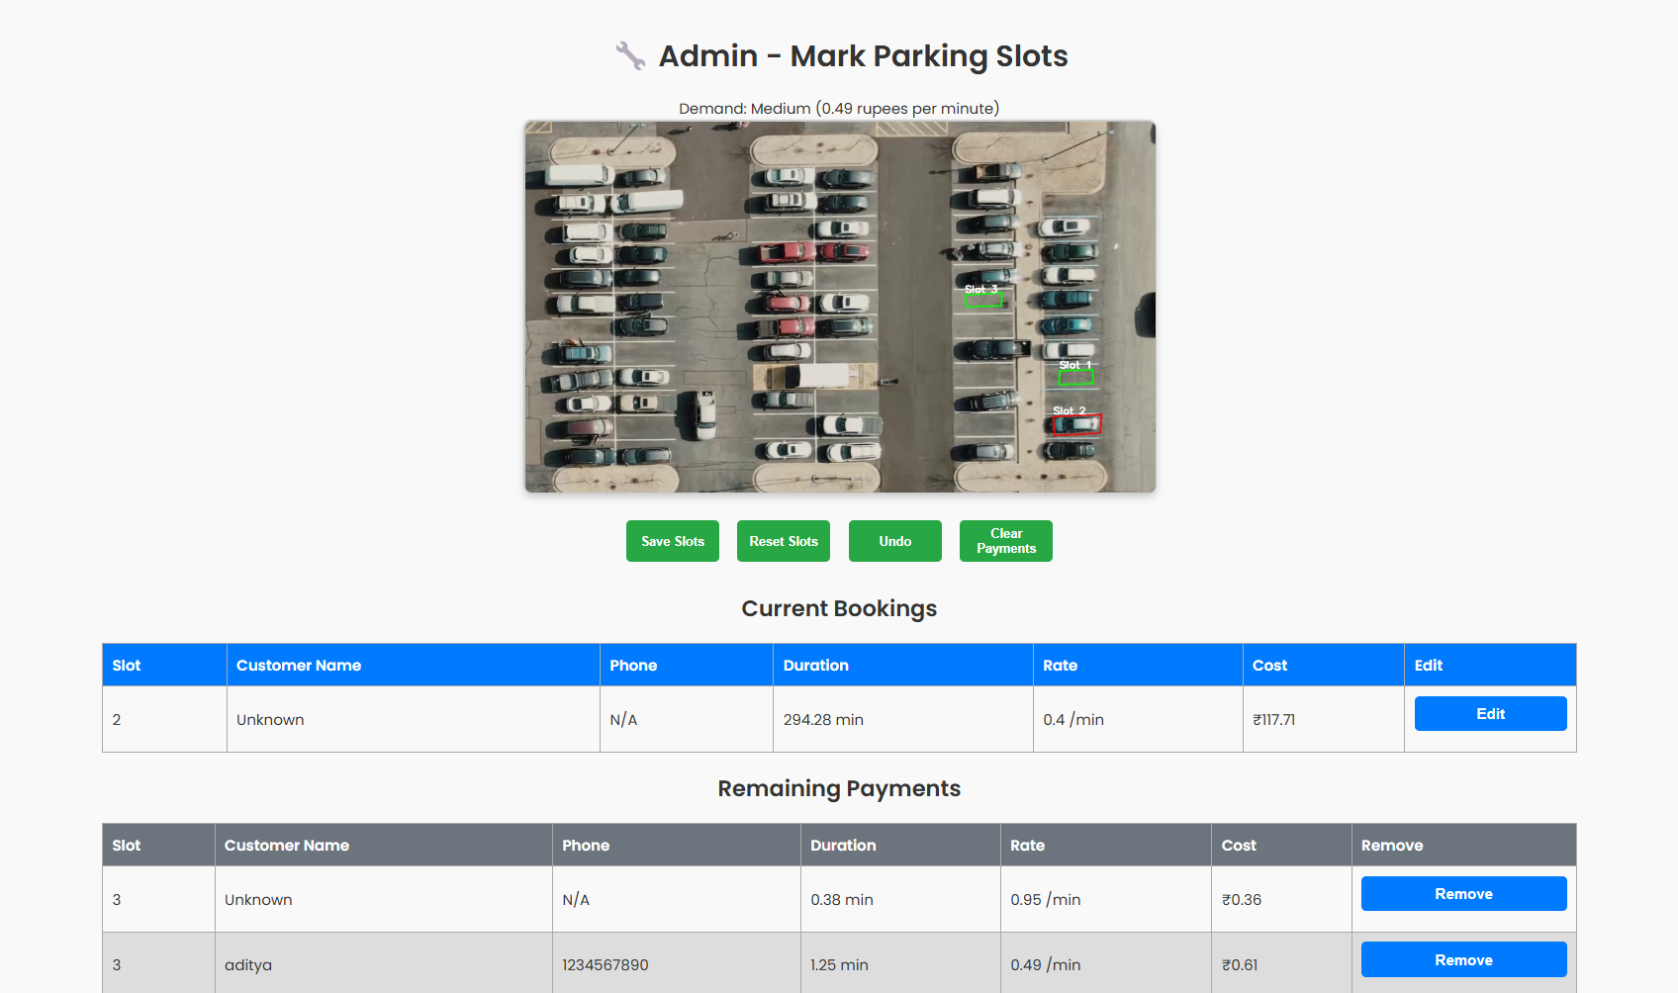
Implementation
Notes:
12

Slide 13
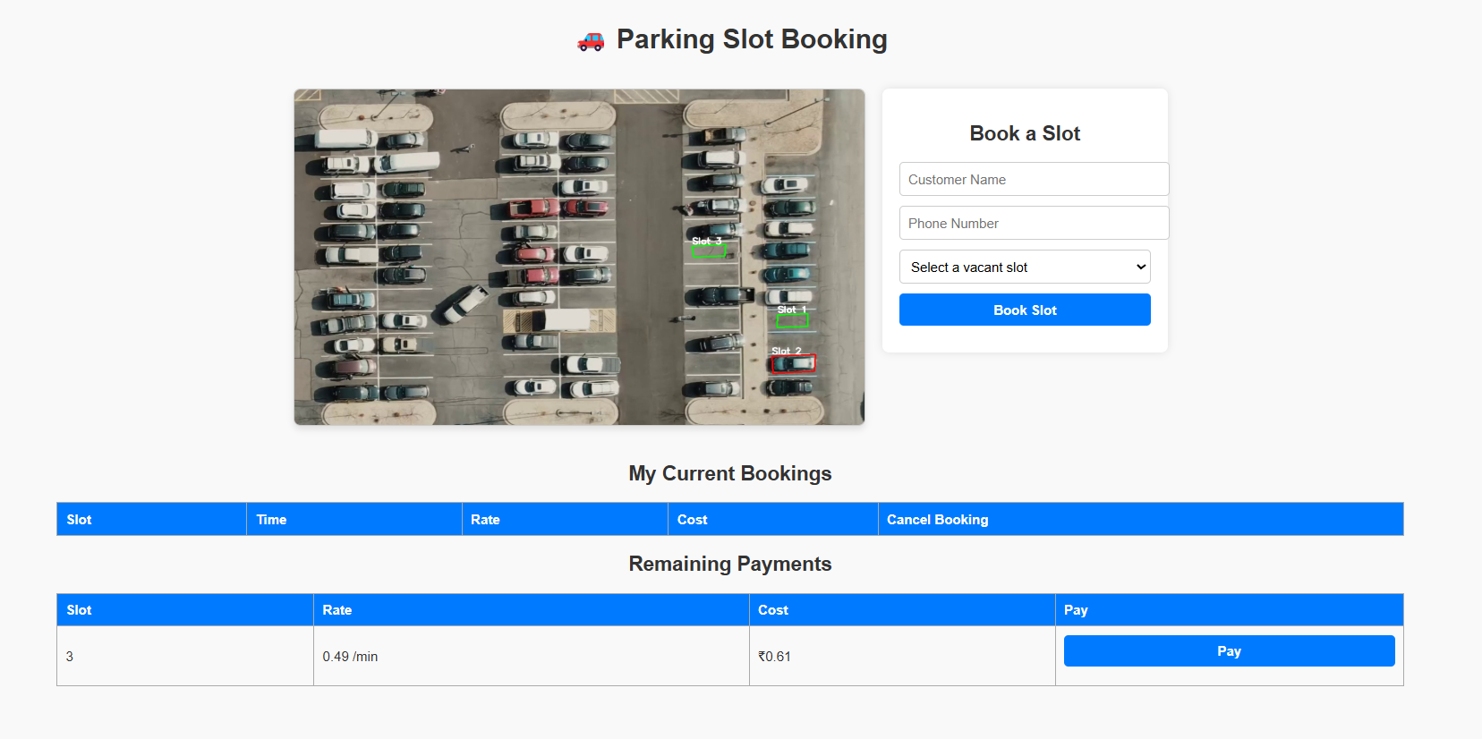

Slide 14
Conclusion
Real-Time Efficiency: The system effectively utilizes live video processing to detect parking occupancy in real time, ensuring immediate and accurate updates.
Cost Reduction: By relying on a camera-based computer vision approach instead of expensive IoT sensors, the project significantly reduces hardware and installation costs.
Integrated Workflow: The unified framework seamlessly connects occupancy detection, slot booking, and payment management, enhancing overall operational efficiency.
User-Friendly Interfaces: Tailored interfaces for both administrators and users simplify parking slot management, from dynamic slot marking to easy booking and cancellation.
Scalability and Flexibility: The modular Flask-based architecture allows for easy future enhancements and adaptation to various parking configurations and demand scenarios
Notes:
14

Slide 15
References
[1] A. Kumar, B. Singh, and C. Patel, "Real-Time Parking Slot Detection Using Image Processing Techniques," 2018 IEEE International Conference on Intelligent Transportation Systems ,Singapore, 2018, pp. 500-505, doi: 10.1109/ITSC.2018.1234567.
[2] D. Li, F. Wang, and J. Chen, "Deep Learning for Parking Occupancy Detection: A CNN-Based Approach," 2019 IEEE Intelligent Vehicles Symposium (IV), Beijing, China, 2019, pp. 200-205, doi: 10.1109/IV.2019.9876543.
[3] S. Rahman and M. Alam, "Smart Parking Systems: Integrating Computer Vision and IoT for Urban Mobility," 2020 5th International Conference on Smart City Applications (ICSC), Dubai, UAE, 2020, pp. 110-115, doi: 10.1109/ICSC.2020.1023456.
[4] M. Hernandez, P. Garcia, and L. Torres, "Efficient Parking Space Detection and Vehicle Localization Using Machine Vision," 2019 IEEE Conference on Automation Science and Engineering (CASE), Las Vegas, NV, USA, 2019, pp. 312-317, doi: 10.1109/CASE.2019.8765432.
[5] R. Gupta and S. Kumar, "Robust Parking Slot Occupancy Detection Using Image Processing and Machine Learning Techniques," 2021 7th International Conference on Computing and Communication Technologies (IC3T), New York, NY, USA, 2021, pp. 150-155, doi: 10.1109/IC3T.2021.1357924.
Notes:
15

Slide 16
Thank You...!!
Notes:
16

